Slide 1
Small Area Estimation
Yijun Liu
Department of Computer Science
University of Wyoming
Rao, John NK, and Isabel Molina. Small area estimation. John Wiley & Sons, 2015.

Slide 2
Introduction
An Overview of SAE methods
Linear Mixed Models (LMMs)
Small Area Estimation with Linear Mixed Model
Conclusion and Future Work

Slide 3
Introduction
Censuses and administrative records have limited scope. Sample surveys can provide reliable current statistics for large areas or subpopulations (domains) with large sample sizes.
Growing demand for reliable small area statistics but sample sizes are too small to provide direct (or area specific) estimators with acceptable accuracy.

Slide 4
Small Area Estimation
In the sampling survey, Domain or subpopulation is called a small area if the domain-specific sample size is small.
It is necessary to borrow strength from related areas through linking models based on auxiliary data such as recent census and administrative records. This leads to indirect estimators.
Estimation of counts and rates for school-age children under poverty in the USA at the county and school district level. More than 15 billion dollars of federal funds are allocated annually.

Slide 5
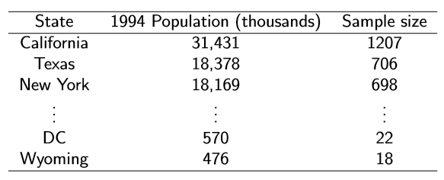
Small Area Estimation: Example
US sample sizes with an equal probability of selection method sample of 10,000 person.
Suppose to measure customer satisfaction for a government service: California 24.86% → leads to a conﬁdence interval of 22.4%-27.3% (reliable) Wyoming 33.33% → leads to a conﬁdence interval of 10.9%-55.7% (unreliable → need SAE)

Slide 6
SAE: classiﬁcation
There are several classiﬁcations of SAE methods, Some of these classiﬁcations cross each other.
Direct methods use only domain-speciﬁc data
Indirect methods borrow information from all the data
1. Synthetic Estimation
2. Composite Estimation
Design-based (Model-assisted) methods
Direct estimation
Can allow for the use of models (model-assisted)
Model-based methods
Borrow strength by using a model
Estimation using frequentist or Bayesian approaches

Slide 7
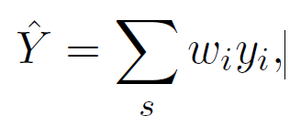
Approaches to Small Area Estimation
Direct Estimation
Following the definition given by Rao (2003), a small area estimator is direct when it uses the sample values of study variables from the specified area only.
where w_{i} are the design weights, s is a selected sample, i ∈ s

Slide 8
Approaches to Small Area Estimation
Indirect Estimation
Synthetic Estimation
Can be considered either model-based or design-based model-assisted. In both cases the specified linear relationship between y (study variable) and the auxiliary variables, described with the parameter (vector of regression coefficients) plays an important role.
2. Composite Estimation
According to Rao (2003), to avoid the potential bias of a synthetic estimator, and the instability of the direct estimator, we consider a convex combination of both, known as the composite estimator.

Slide 9


SAE: classiﬁcation
Area-level models relate small area direct estimators to area speciﬁc covariates. Such models are necessary if unit (or element) level data are not available.
where m is the number of small areas, β is the vector of regression coefficients, v_{i} is the area-specific random effects and e_{i} is the sample error.
Unit level models that relate the unit values of a study variable to unit-speciﬁc covariates.
where y_{ij} is the response of unit j, j = 1; 2; …; ni, in area i, i = 1; 2; … ;m, x_{ij} is the vector of auxiliary variables, β is the vector of regression parameters, v_{i} is the random effect of area i and e_{ij} is the individual unit error term.

Slide 10
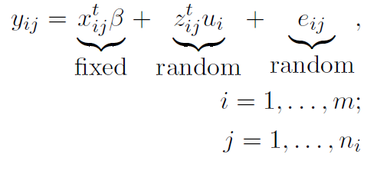
Linear Mixed Models (LMMs)
According to Brady et al. (2007), a simple and general form that indicates how most of the components of an LMM can be written at the level of an individual observation (Level1) in the context of a clustered two-level data set.
y_{ij} = response of j^{th} member of cluster i
m = number of clusters
n_{i} = size of cluster i
x_{ij} = covariate vector of j^{th} member of cluster i for fixed effectsβ = fixed effects parameter
z_{ij} = covariate vector of j^{th} member of cluster i for random effects
u_{i} = random effect parameter

Slide 11
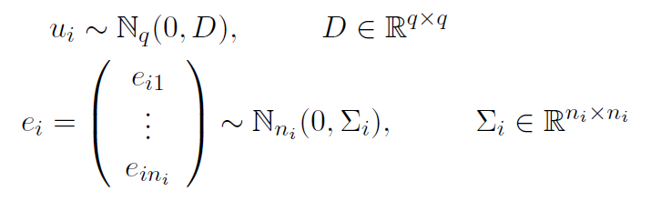
Linear Mixed Models (LMMs)
In the formula, we assumed that:
u₁; … ; u_{m}; e₁; … ; e_{m} are assumed independent, ∑_{i} is covariance matrix of error vector e_{i}
in cluster i and D is covariance matrix of random effects u_{i}.

Slide 12
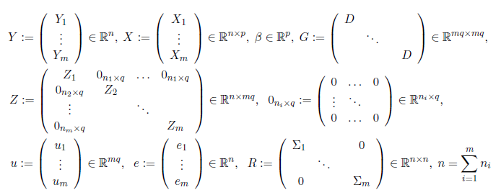
Linear Mixed Models (LMMs)
We can also consider the the general matrix specification of an LMM for a given cluster i,
Y = X + Zu + e;

Slide 13


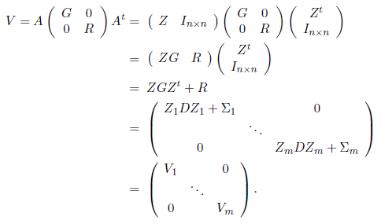

Marginal Linear Model
The marginal model in matrix form is:
with

Slide 14
Maximum Likelihood (ML) Estimation
In general, maximum likelihood (ML) estimation is a method of obtaining estimates of unknown parameters by optimizing a likelihood function.
The corresponding multivariate normal probability density function f(Y | β, θ) is :
Log likelihood is:
Θ combines all covariance parameters contained in u_{i} and e_{i}.

Slide 15
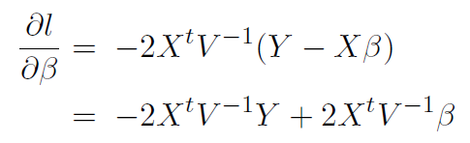

Maximum Likelihood (ML) Estimation
Case 1: Assume θ is Known
Which is also known as the Generalized Least Squares (GLS) estimator when it is assumed that Y has a normal distribution.

Slide 16

Maximum Likelihood (ML) Estimation
Case 2: Assume θ is not Known, we can get
We put this into the log likelihood formula:
The profile log likelihood is then maximized to find θ_{ML}.

Slide 17


Small Area Estimation with Linear Mixed Model
Suppose that the population U of size N is divided into M disjoint areas and that the survey estimates are available for m, m<=M, of the areas.
where N_{i} is the size of area population U_{i}, i = 1; 2; … ;M: Assume then that a random sample s of size n is drawn from U and

Slide 18





Nested Error Regression Model
The model proposed is:
Here y_{ij} is the response of unit j in area i, x_{ij} is the corresponding vector of auxiliary
variables, β is the vector of fixed parameters, u_{i} is the random effect of area i and e_{ij} is the random individual error term.
The area effects u_{i} are assumed independent with zero mean and variance . Similarly, the errors e_{ij} are independent with zero mean and variance . Than we have:

Slide 19

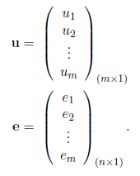
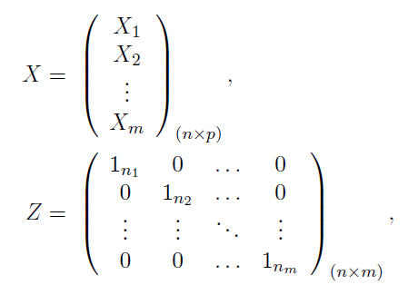
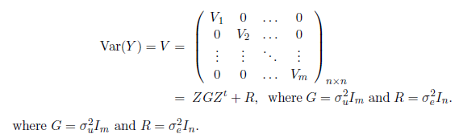
Nested Error Regression Model
We can also have the matrix form, The model is now

Slide 20
Conclusion and Future Work
In this work we have considered model-based approaches to finding the estimates of small area target quantities. The linear mixed model was used to find the estimates for the regression coefficients and the variance components using the Maximum Likelihood Estimation (MLE).
The linear mixed models that we revised in this talk are generally used in the situations where the observations are continuous and assume that the relationship between the mean of the dependent variable and the covariates can be modeled as a linear function.
However, in some cases, the linear mixed models do not apply. The generalized linear mixed model is the most frequently used random effects model in the context of discrete repeated measurements.

Slide 21
Thank you

